Slide 1
Penetration Testing
Gathering Information
Dr. Tran The Son
Vietnam – Korea University

Slide 2
Open Source Intelligence Gathering
Port Scanning

Slide 3
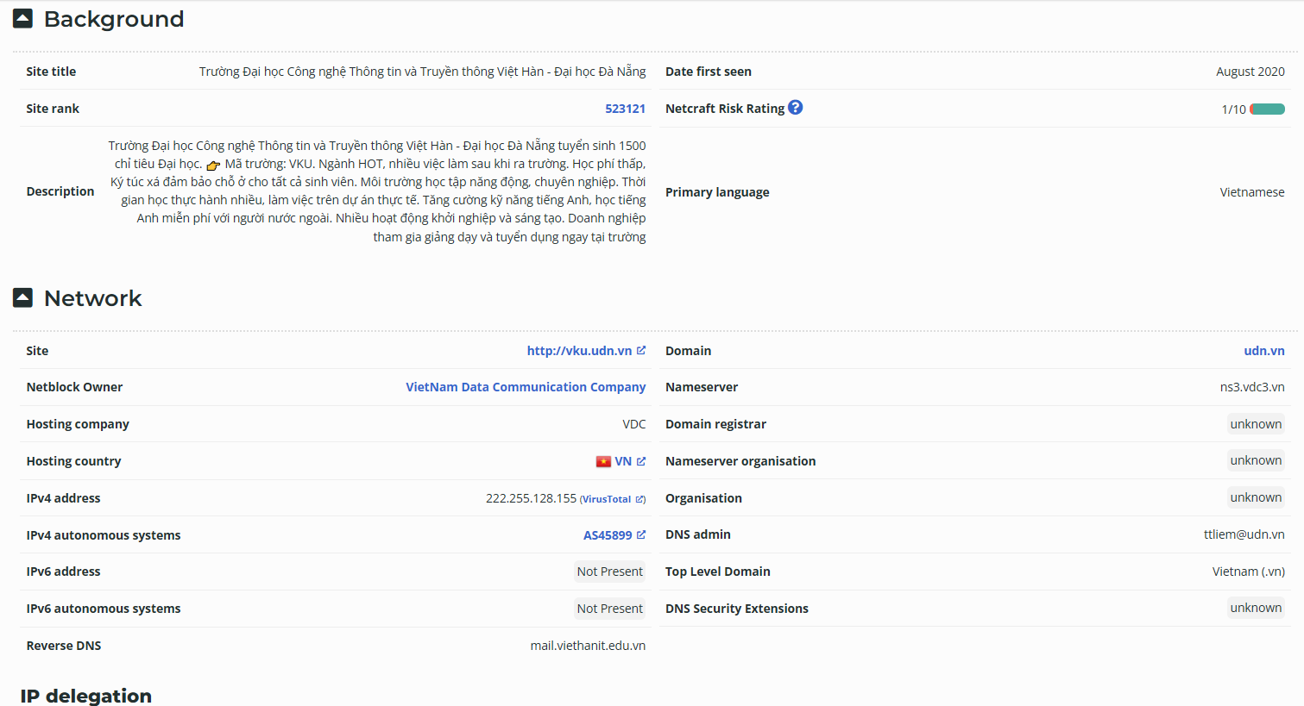
Netcraft
Sometimes the information that web servers and web-hosting companies gather and make publicly available can tell you a lot about a website.
  http://www.netcraft.com/

Slide 4
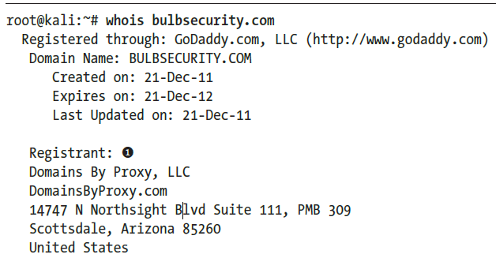
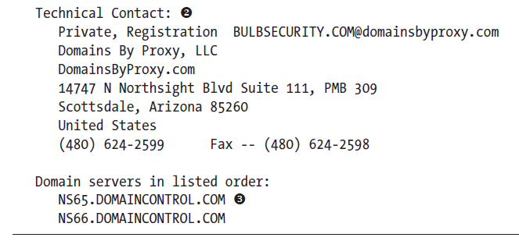
Whois Lookups

Slide 5
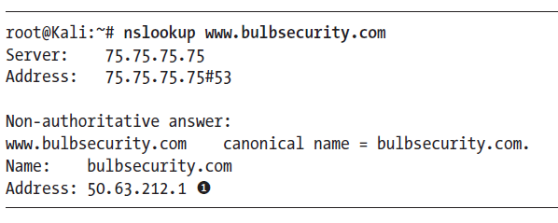
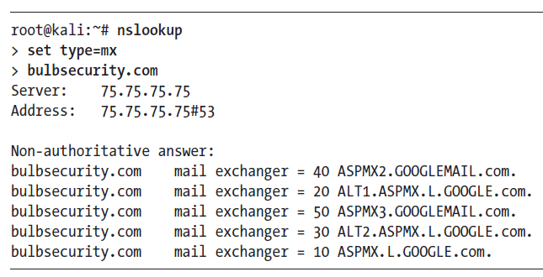
DNS Reconnaissance

Slide 6
nslookup
nslookup [-opt ...] host # just look up 'host' using default server
nslookup [-opt ...] host server # just look up 'host' using 'server‘
set OPTION - set an option
all - print options, current server and host
[no]debug - print debugging information
[no]d2 - print exhaustive debugging information
[no]defname - append domain name to each query
[no]recurse - ask for recursive answer to query
[no]search - use domain search list
[no]vc - always use a virtual circuit
domain=NAME - set default domain name to NAME
srchlist=N1[/N2/.../N6] - set domain to N1 and search list to N1,N2, etc.
root=NAME - set root server to NAME
retry=X - set number of retries to X
timeout=X - set initial time-out interval to X seconds
type=X - set query type (ex. A,AAAA,A+AAAA,ANY,CNAME,MX,NS,PTR,SOA,SRV)
querytype=X - same as type
class=X - set query class (ex. IN (Internet), ANY)
[no]msxfr - use MS fast zone transfer
ixfrver=X - current version to use in IXFR transfer request
server NAME - set default server to NAME, using current default server
lserver NAME - set default server to NAME, using initial server
root - set current default server to the root
ls [opt] DOMAIN [> FILE] - list addresses in DOMAIN (optional: output to FILE)
-a - list canonical names and aliases
-d - list all records
-t TYPE - list records of the given RFC record type (ex. A,CNAME,MX,NS,PTR etc.)
view FILE - sort an 'ls' output file and view it with pg

Slide 7
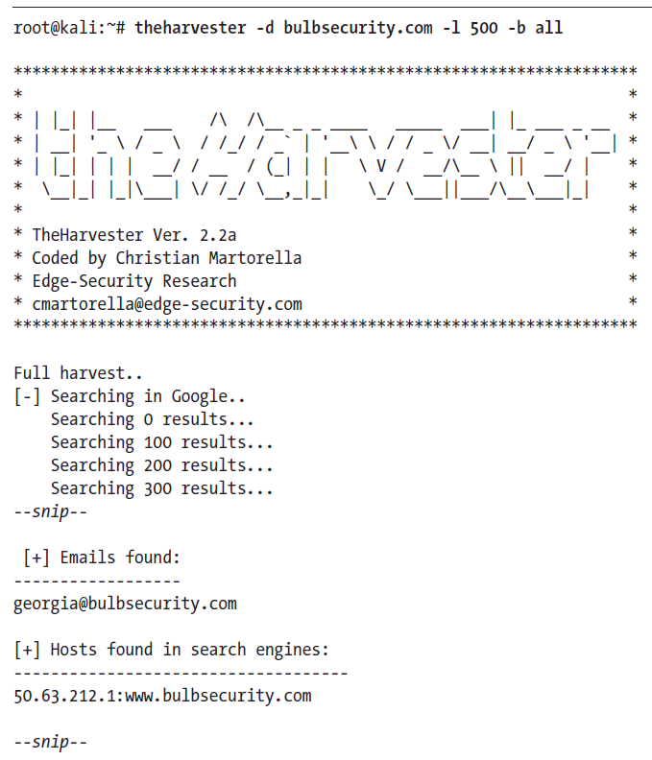
Searching for Email Addresses

Slide 8
theHarvester
theHarvester [-h] -d DOMAIN [-l LIMIT] [-S START] [-p] [-s]
[--screenshot SCREENSHOT] [-v] [-e DNS_SERVER]
[-r] [-n] [-c] [-f FILENAME] [-b SOURCE]
-d DOMAIN, --domain DOMAIN
Company name or domain to search.
-l LIMIT, --limit LIMIT
Limit the number of search results,
default=500.
-S START, --start START
Start with result number X, default=0.
-p, --proxies Use proxies for requests, enter proxies in
proxies.yaml.
-s, --shodan Use Shodan to query discovered hosts.
--screenshot SCREENSHOT
Take screenshots of resolved domains
specify output directory: --screenshot
output_directory
-v, --virtual-host Verify host name via DNS resolution and
search for virtual hosts.
-e DNS_SERVER, --dns-server DNS_SERVER
DNS server to use for lookup.
-r, --take-over Check for takeovers.
-n, --dns-lookup Enable DNS server lookup, default False.
-c, --dns-brute Perform a DNS brute force on the domain.
-f FILENAME, --filename FILENAME
Save the results to an XML and JSON file.
-b SOURCE, --source SOURCE

Slide 9
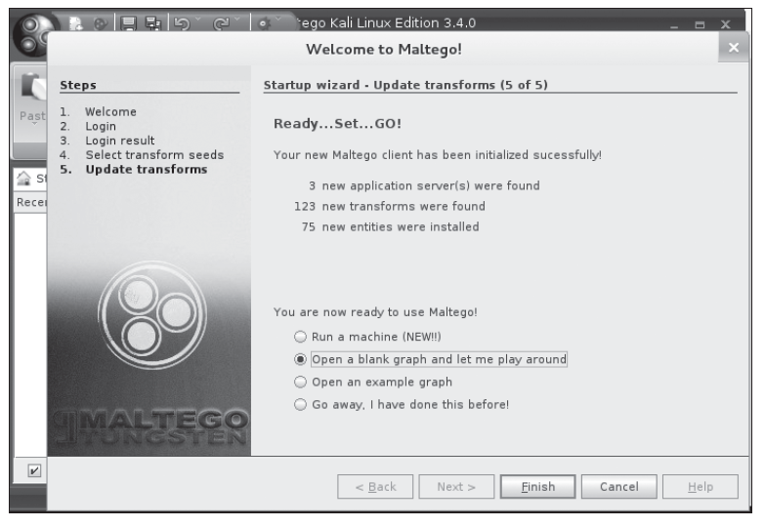
Maltego
Paterva’s Maltego is a data-mining tool designed to visualize open source intelligence gathering.
Maltego has both a commercial and a free community edition.

Slide 10
Port Scanning
Manual Port Scanning
Port Scanning with Nmap

Slide 11
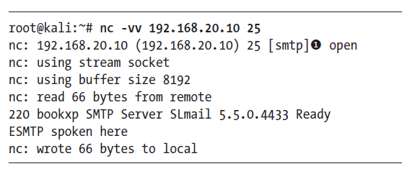
Manual Port Scanning
We can do this manually by connecting to ports with a tool such as telnet or Netcat and recording the results

Slide 12
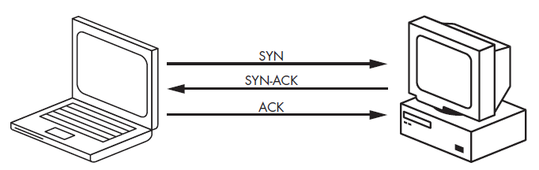
Port Scanning with Nmap
Nmap is an industry standard for port scanning.
Firewalls with intrusion-detection and prevention systems have made great strides in detecting and blocking scan traffic, so you might run a scan and receive no results at all
Nmap finds out if a port is open without ever fully connecting to the target machine using SYN scan
The syntax for a SYN scan is the -sS flag
A SYN Scan

Slide 13
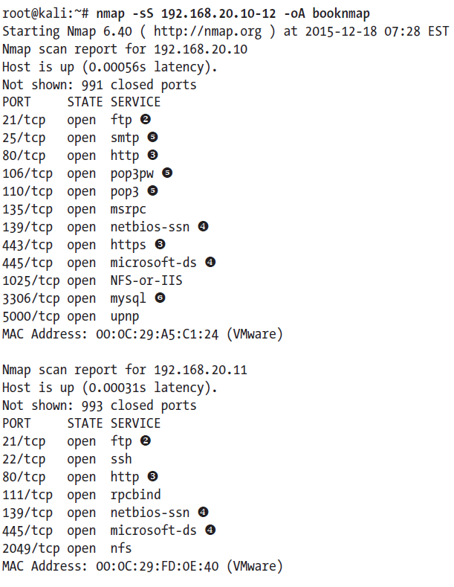
Nmap: SYN Scan [-sS]
The syntax for a SYN scan is the -sS flag
The -oA option tells Nmap to log our results in all formats: .nmap, .gnmap (greppable Nmap), and XML
A SYN Scan

Slide 14
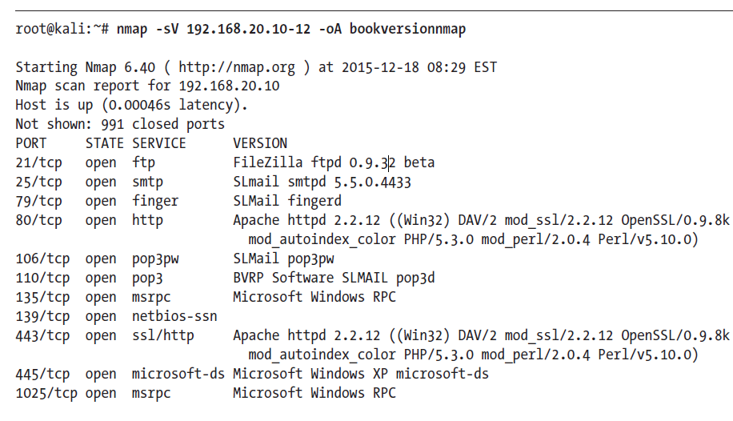
Nmap: Version Scan [-sV]
In the version scan, Nmap completes the connection and attempts to determine what software is running, the version, using techniques such as banner grabbing.
A Version Scan

Slide 15
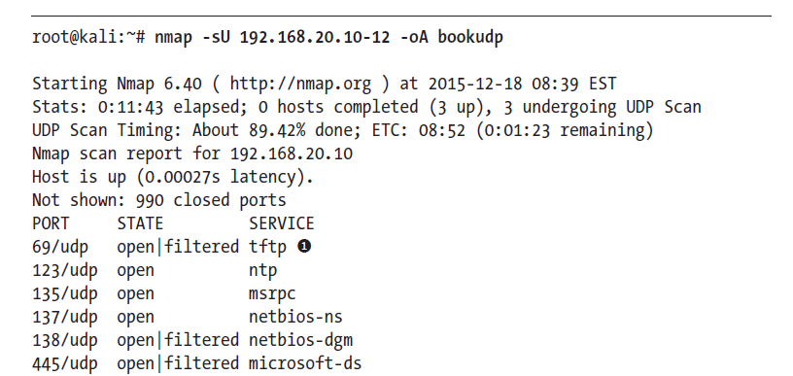
Nmap: UDP Scan [-sU]
In a UDP scan (-sU), Nmap sends a UDP packet to a port. Depending on the port, the packet sent is protocol specific.
    If it receives a response, the port is considered open.
    If the port is closed, Nmap will receive an ICMP Port Unreachable message.
Nmap is not always able to distinguish between an open UDP port and one that is filtered by a firewall.

Slide 16
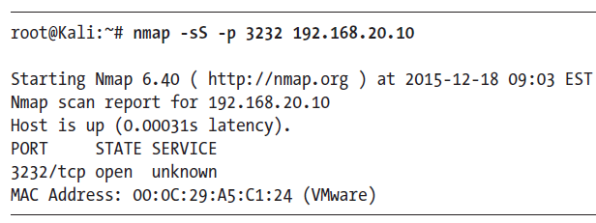
Nmap: Scanning a Specific Port
By default, Nmap scans only the 1,000 ports it considers the most “interesting,”not the 65,535 TCP /UDP ports

Slide 17
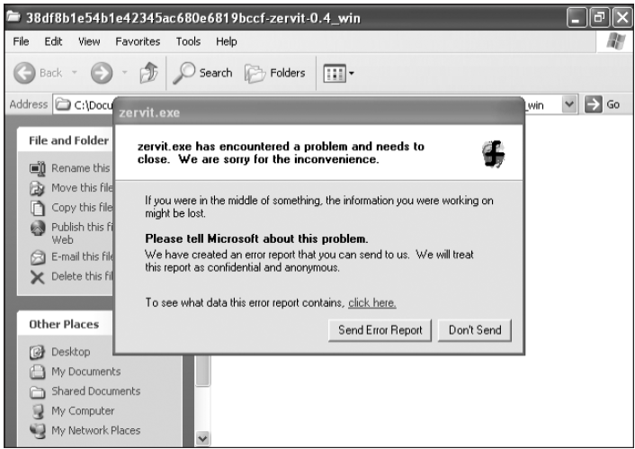
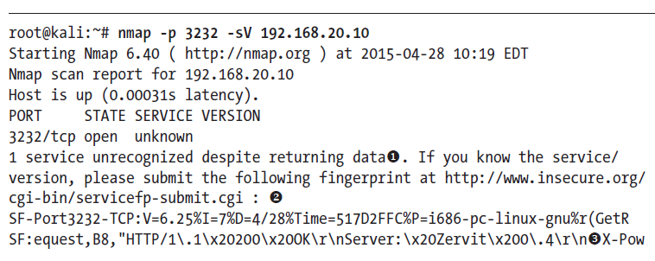
Nmap: Scanning a Specific Port
if we try to probe the port a bit more aggressively with a version scan (see Listing 5-10), the service listening on the port crashes
A good rule of thumb is to specify ports 1 through 65535 on your pentests, just to
make sure there’s nothing listening on those other “uninteresting” ports.

